Slide 1
Tips and Recommendations before you get started
Family Experience: Consider how to make the event FUN and INFORMATIVE for your families. Consider using Scavenger Hunt, Passport, and other ways to engage families while learning about the wonderful world of Title I!
Cross-Coordination: This continues to be an area of focus. Please consider how you can use other federal funds (Title III, IDEA, Business/Community) to maximize your event.
Family Engagement supporting document: Please consider using the Family Engagement documents for the Planning and Post-Event Summary for your reference.
Presentation Key:
- Optional - Required

Slide 2

Data Sources/Consider
Comprehensive Needs Assessment
School Improvement Plan
District Climate Survey (Title I Items)
PM3 Data/Connection to Phase III
Notes:
Calling out some data sources to get them started…

Slide 3

All About Title I
Title I is the largest federal assistance program for our nation’s schools.
The program serves 85 schools in Pinellas County including eligible students in 36 non-public schools.
Notes:
Highlight the Title I Program here in Pinellas County.

Slide 4


Title I Annual Parent Meeting
Pinellas Gulf Coast Academy
September 19, 2023
Virtual
Carmela Haley
Notes:
Evidence: Upload completed presentation and recorded feedback as part of the evidence to support the Annual Meeting Materials. Do not forget the sign-in sheets, and survey/feedback that you receive throughout the meeting.

Slide 5
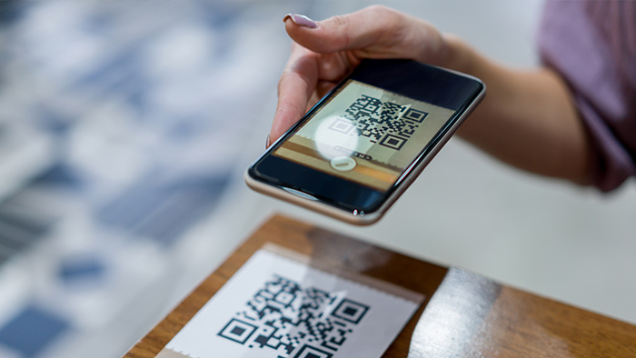
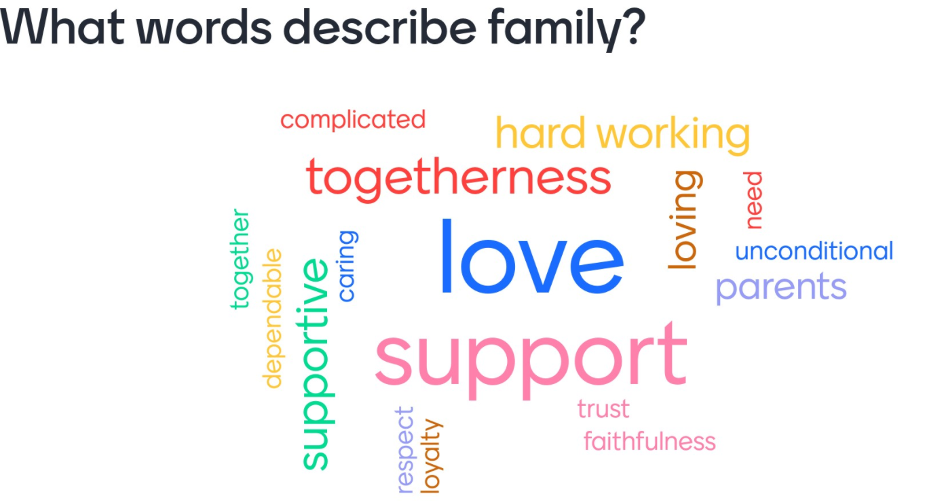
Opportunity to Build School and Home Relationships
Engagement Tip!
Get to know your families by inserting a get to know you and your child icebreaker activity.
Snip and paste a QR code for convenience.
*Check out Mentimeter.com*
Notes:
Insert icebreaker or a “get to know you/your family” activity here! Use the icebreaker to take attendance AND get to know something about your families to help support student achievement.
Evidence: Use the responses from icebreaker as evidence to support the next steps related to future engagement activities and student achievement.

Slide 6

Title I Funding Process
2. Florida Department of Education
1. Federal Government
3. Pinellas County Schools
4. Pinellas Gulf Coast
Notes:
The Florida Department of Education receives funds from the federal government. Districts receive Title I funds from Department of Education, and the school district distributes these funds to schools based on the percentage of children eligible for free/reduced price lunch; however, students do not have to be from low-income families to receive help.

Slide 7

Title I
Supplemental Resources
Definition: provided in addition to what is already present or available to complete or enhance it.
https://languages.oup.com/
Notes:
Title I is supplemental federal funding that provides ADDITIONAL resources to families.
Definition: provided in addition to what is already present or available to complete or enhance it extra academic support and learning opportunities for economically disadvantaged students.

Slide 8

Education, then, beyond all other divides of human origin, is a great equalizer of conditions of men.”
– Horace Mann

Slide 9
Title I Programs Provide Supplemental Support
Get creative to “Highlight” your Title I resources. See notes section below for supplemental activities for the 2023-24 school year.
  Expected outcomes from Title I funded Professional Development
  Share pictures of an event or activity that was supported through Title I funding
  Highlight an upcoming parent engagement event
  Have students share their experiences! Insert a quick video clip
  Make connection between resources and student proficiency and learning gains
  Attending a great professional development, including conferences and consultants
Notes:
Use additional slides if necessary. This is where you want to really highlight Title I funding and how it positively impacts your scholars!
Additional supplemental personnel (add specific positions)
Additional training opportunities for school staff (add specific trainings offered at your site)
Extended Learning Opportunities (before and/or after school programs)
Supplemental teaching materials, equipment, and technology
Parent and Family Engagement Resources and Training Workshops

Slide 10


Let’s Celebrate!
Highlight areas of growth BASED ON FAST AND SCHOOL Trends, including connections to the Title I Resources.
Highlight areas of growth!
Notes:
Based on the FAST data and school grades, there is a lot to celebrate!!
How did your Title I Resources support or enhance the work that you were able to get done?
How will you shift resources to support the latest data?

Slide 11
Title I Programs Provide Supplemental Support
Supplemental Resource | Positive Impact
Additional supplemental personnel | Campus Monitor Family Community Liaison
Additional training opportunities for school staff | Two conferences: PBIS Conference – Nashville, TN Student Success Conference – Bureau of School Improvement, Orlando
Parent and Family Engagement Resources and Training Workshops | Parent Engagement workshops and resource fairs
Notes:
Use additional slides if necessary. This is where you want to really highlight Title I funding and how it positively impacts your scholars! Additional supplemental personnel (add specific positions)
If there are connections that they can make, they call it out!

Slide 12
Title I Schoolwide Planning and Input
First
Second
Last
Seek Input from school, family, and community members determine how Title I funds are used based on a needs assessment.
Please attend online or in-person meetings/trainings and complete surveys to provide input on Title I funding.
All Title I schools must document that parents are involved in the schoolwide planning process.
Notes:
Evidence for input – input from school can be a survey or notes, which include quotes related to what was shared as feedback AND how this input will be used to inform the PFEP and future engagement activities.
Evidence of Attendance – please include attendance of DIVERSE stakeholder group/s.

Slide 13

Title I Schoolwide Budget
Pinellas Gulf Coast Academy is provided $39,564 to pay for supplemental resources and programs for increased student achievement.
Examples are:
Supplemental hours for Parent Community Liaison
Family Engagement Resources
Campus Monitor
Teacher training to improve student engagement and performance
PBIS program
Classroom Instructional Supplies

Slide 14

Parent’s Right to Know
As a parent of a student attending a Pinellas County School Public School, you have the right to…
Be
Be provided information on your child’s level of achievement on assessments in Reading/Language Arts, Writing, Mathematics, and Science.
Request and receive information on the qualifications of your child’s teacher and supplemental personnel working with your child.
Be
Be notified of non-highly qualified or out-of-field teachers at the school.
Be
Be informed if your child is taught by a non-highly qualified teacher for four or more consecutive weeks.

Slide 15
Working Together for Student Success
School
School Improvement Plan (SIP)
Title
Title I Schoolwide Plan
Parent
Parent and Family Engagement Plan
School
School-Parent-Student Compact
Notes:
As a Title I parent you have the right to be involved in the development of the following plans and documents for our school which can be found on our website (insert website) to view as well as in the Parent Station located (insert location here).
Our school’s Title I Parent Station is located (insert location or photo of Title I Parent Station (front office and on the webpage). Please include photo as part of the evidence monitoring.
You will find a copy of our School Improvement Plan, Title I Schoolwide Plan, School’s PFEP, the School District’s PFEP, Parent’s Right to Know Memo, Upcoming Events, Compact, (insert other documents at your station)
School Improvement Plan (SIP)
Parent and Family Engagement Plan
Title I Schoolwide Plan
School-Parent-Student Compact

Slide 16
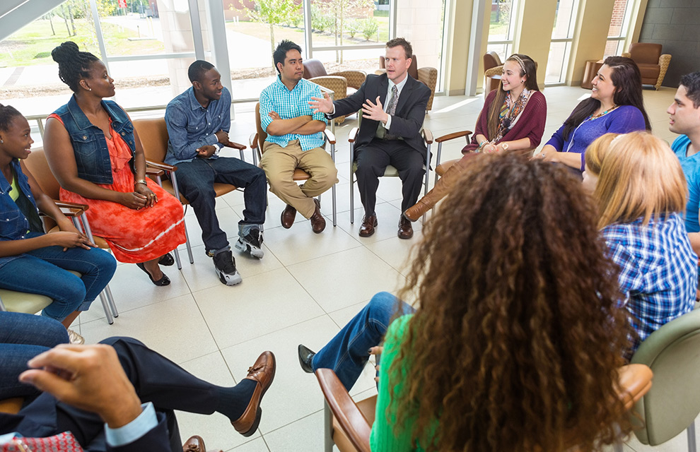
Parent and Family Engagement Plan (PFEP)
The PFEP Sections include information about the following:
  Parent trainings to increase student achievement
  Staff trainings for engaging parents
  Communication methods between home and school
  Flexible meeting times
  Accessibility for parents
  Coordinating with other Federal Programs
Notes:
Provide information on the specific committees that parents can be involved. Include the purpose, date and time of meetings.
Explain the PFEP and its purpose.
Consider the evidence related Title I Crate, Sample of Evidence,

Slide 17
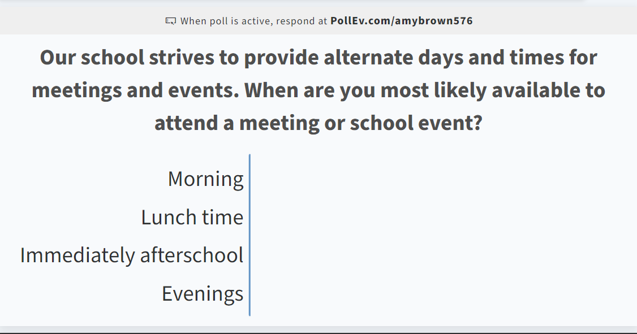
Opportunity for Two Way Communication
As mentioned in the previous slide, the PFEP ensures to provide families with flexible meeting times.
Engagement Tip!
Conduct a quick poll to find out what times work best for your families.
*Check out polleverywhere.com*
Notes:
Evidence – please keep this as evidence to support using feedback to inform flexible meetings.

Slide 18


Florida Benchmark For Excellent Student Thinking Standards (B.E.S.T). You may read more information by visiting, www.fldoe.org.
Notes:
All curriculum, instruction and assessments are based on student-centered expectations.

Slide 19

School’s Curriculum
Florida Benchmark For Excellent Student Thinking Standards (B.E.S.T). form the framework of everything taught at school.
Core Curriculum - Edmentum
  Reading
  Mathematics
  Writing
  Science
Notes:
This slide is optional if this will be discussed with classroom teacher
School’s Curriculum
Describe and explain the curriculum (Specific names of texts)

Slide 20
Florida End of Course (EOC)
Assessments
(Algebra 1, Biology, Civics, U.S. History, Geometry)
To learn more about state assessments visit the Florida Department of Education’s website, fldoe.org/accountability/assessments.
Notes:
This slide is only required, if it applies.

Slide 21

Accountability
  School Report Cards
  School Grade and Overview
  Population and Enrollment
  Assessments – Academic Achievement, Growth, and Population
  Assessments – English Language Learners
  Graduation and Beyond
  Educator Qualifications and Equity
  Long-Term Goals and Interim Progress
  Accelerated Course Enrollment
  Per-Pupil Expenditures
  National Data
  Available online at https://edudata.fldoe.org/ or Front Office

Slide 22
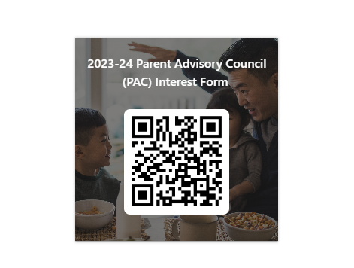

Parent Advisory Council (PAC)
The District has a Parent and Family Engagement Plan. The summary of the plan is in the Title I School & Family Partnership Overview.
You may access the full plan at www.pcsb.org/titleone
The Parent Advisory Council (PAC) is responsible for reviewing and revising the District PFEP.
PAC will meet virtually or in-person with the district’s Title I staff.
Each school is committed to having at least one member representative on PAC.
PAC meets twice a year, if you are interested in representing our school please notify, Insert contact person
Notes:
Please add your PAC representative in slide and share with your Title I Specialist.
https://forms.office.com/r/r5daaMTENE\

Slide 23
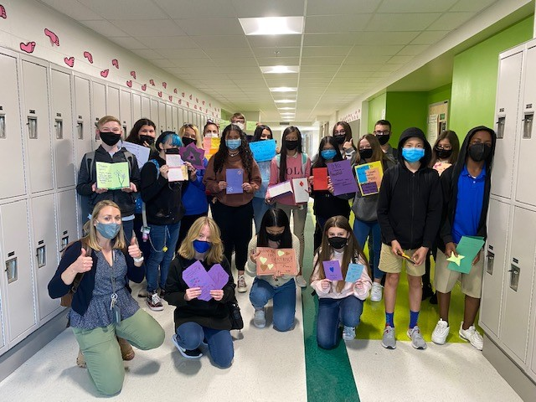

Additional Resources
Learning at Home Family Resources - https://www.pcsb.org/Page/32836
Volunteer in a Pinellas County School - https://www.pcsb.org/Page/459
Parent Academy POWER HOURS Webinars - https://www.pcsb.org/Page/26534
Partnerships - https://www.pcsb.org/Page/418

Slide 24

Thank you for your time!

Slide 25

Contact Us
2235 NE Coachman Rd.
Clearwater, FL 33765
(727)-474-8836
haleyc@pcsb.org
Notes:
Please insert the school contact information and the best way to reach out to the school.

Slide 26


Slide 27
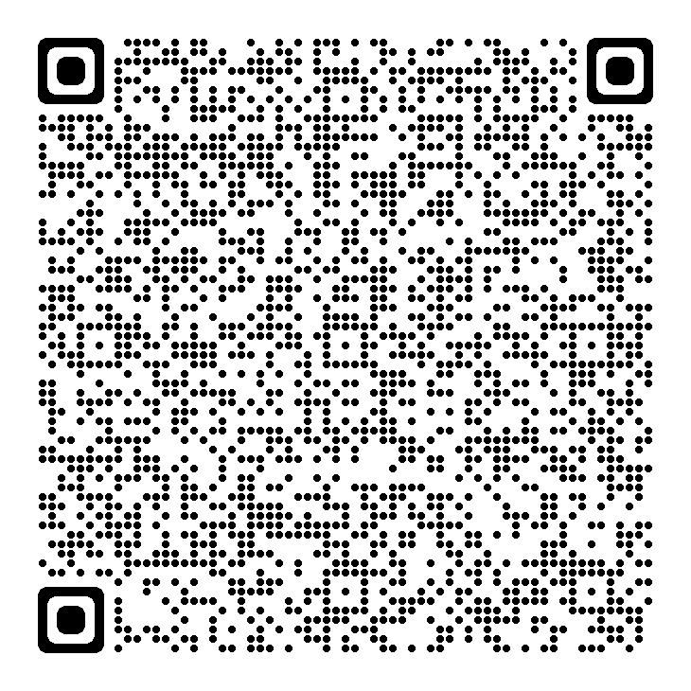
Please take the time to participate in our survey.
https://forms.office.com/r/wem5my9CiS?origin=lprLink
Your feedback is greatly appreciated!
Notes:
Please duplicate Microsoft Forms provided or create school survey. To generate a QR code hover over your school’s survey and right click. Create QR code for this page will be an option.
https://forms.office.com/Pages/ShareFormPage.aspx?id=BZM8c9c5GkaGb_3ye_PH_x-1YNVO6C1FkgA88U6PR2tUNEQzTU0wNkZXVUxVTlpEMU81NkJFMlJNTi4u&sharetoken=FXXhmgwFjSnl0sNz61ki

